Slide 1

Communications Leader
Thomas Schaffner
T: 267-251-1459
www.linkedin.com/in/tomschaffner
schaffnertf@gmail.com
https://tomschaffner.com/ (portfolio)

Slide 2

In This Presentation …
3
11
16
25
34
Professional Background
Internal Communications
Employee Engagement • Culture • Change Management
External Communications
Media Relations • Public Relations • Branding
Customer Communications
Communication Channels • Engagement • Marketing
Executive Communications
Internal • Industry • Media Coverage

Slide 3
Professional Background

Slide 4
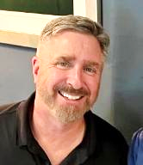
About Me
I am an award-winning writer and communications leader with a history of delivering proven results in messaging, branding and content creation for organizations of all sizes. With a background in communications, public relations, marketing and change management, I have created and successfully implemented communications plans and campaigns for all types of audiences in multiple media settings.
As both a former member of the media and a company representative to the media, I have a unique perspective on how information is best delivered to employees, consumers and organizations with optimal results.
In addition, I have led internal teams and advised company leadership in media and communications best practices, created and managed employee and customer engagement programs, and established key messaging and brand within and outside of the organization.
The following presentation is designed to showcase my professional experience and highlight some examples of my work throughout my career.

Slide 5
Professional Experience
Corporate Communications Manager
ATRIO Health Plans (Nov. 2023 – Present)
Sr. Advisor, Change Management & Communications
Cigna (Nov. 2020 – Nov. 2023)
Director of Corporate Communications
Optum/United Health Group
(formerly Executive Health Resources)
(Jan. 2011 – Jan. 2020)
Public Relations Manager
Siemens Healthcare (Jan. 2008 – Jan. 2011)
Editor in Chief/Editorial Director
Valley Forge Publishing Group
(May 2002 – Jan. 2008)
Corporate, Internal, External &
Executive Communications
Strategic Communications Planning, Branding & Messaging
Public & Media Relations
Employee & Customer Engagement
Web Site & Social Media Content
Crisis & Change Management
Writing & Copyediting
Staff Leadership
Marketing, Campaign &
Event Management
To view my full resume, please click here.

Slide 6
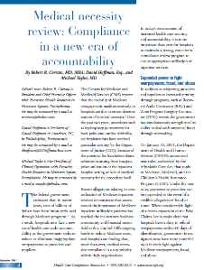
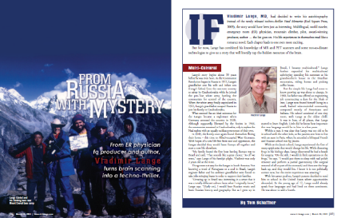
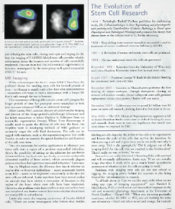
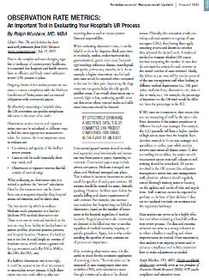
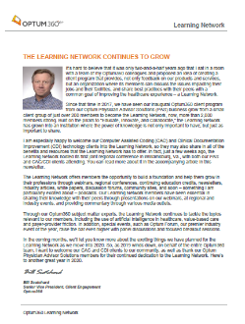
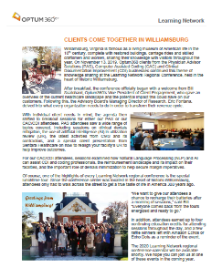
Award-Winning Writer
Profiles
Technology Pieces
Case
Studies
Award-winning writer
White
Papers
Thought Leadership Content
To view writing samples, visit https://tomschaffner.com/media-portfolio/

Slide 7




Awards & Recognitions
American Society of Business Publication Editors Awards: Radiology Directory
(2005-2007); Cover Design (1998, 2000, 2005, 2007, 2008); Case History (1999); New Web Publication (2005); Opening Page/Spread (2005-2008); Individual Profile (2007)
American Society of Healthcare Publication Editors Awards: Case Study (2006); Radiology Directory (2006, 2007); Cover (2005-2008); Opening Spread (2007, 2008)
Association for Publication Excellence (APEX) Awards: Profile Article (2005); Technical Article (2006); Newsletter (2005); Cover (2007); Annual Radiology Directory (2006, 2007)
Medical Marketing & Media Award for marketing communications innovation in producing media exposure through an online auction benefitting the Children’s Health Fund (2009)

Slide 8

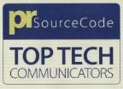


Awards & Recognitions (continued)
Optum (United Health Group) Inspire Marketing Award (Finalist) for the successful Optum360 rebranding campaign for the business unit (2019)
PRSourceCode Award for Siemens Healthcare U.S. as one of the top corporate public relations teams in the technology industry, as well as top honors in the healthcare sector (2010)
Siemens Communications Award (awarded across the global organization) for team collaboration and creativity in promoting the Siemens brand (2008)
Trade Association Business Publications International Awards: b2b Web Site (2008); Single Issue (2004); Cover (2004, 2005, 2007, 2008); Opening Page/Spread (2005, 2007, 2008); Department (2008); Radiology Directory (2006)

Slide 9



Technical & Workplace Skills
Creativity and Connectivity
Web CMS and Desktop Publishing
Gemini AI
Microsoft Office
Adobe Pro / Creative Cloud
Sharepoint
Salesforce
Cision
Associated Press style
WebEx
Zoom
Skype
Microsoft Teams / Power BI
Web Content Management Systems
Umbraco
Dreamweaver
Weebly
WordPress
QuarkXPress
Social Media Platforms:

Slide 10
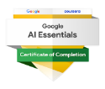

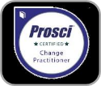

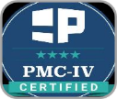
Certifications
AI Essentials Specialization (2025) – Works across roles and industries in essential AI skills as an introduction to AI, how to maximize productivity, write effective prompts, conduct responsible AI and stay ahead of evolving technology.
Social Media Content and Strategy (2025) – Focuses on social media content creation, visuals, messaging, and smart scheduling strategies, design best practices, including layout, brand consistency, and creative workflows.
Prosci Change Practitioner
(2022) – Teaches how to drive successful change initiative, create a functional change management strategy and plans, and to enable individual change and achieve organizational results.
Agile Change Agent (2021) – Benchmarks the ability to scope, plan and manage Agile change initiatives effectively and deliver projects in organizations that require standards, rigor and visibility around the Agile framework.
Pragmatic Marketing Certification (2020) – Validates expertise in product management and marketing, emphasizing practical skills and actionable strategies for navigating the complexities of product lifecycle management.

Slide 11

14 Years’ Experience
Corporate Communications
Leadership / Manager Communications
HR Communications
IT Communications
Change Management
Employee Engagement
Culture Programs
Social Responsibility
Intranet Content
Employee Newsletters
Town Halls
Event Management
Internal
Communications

Slide 12
Employee Communications
Responsible for all aspects of internal communications, employee engagement and promotion of company initiatives.
HR, IT, Sales, Operations and Leadership updates
Social responsibility opportunities
Career opportunities and continued learning opportunities
Organization, team and
milestone announcements
Employee appreciation, team
and family events
Awards and recognitions (Town Halls, leadership announcements)
Intranet highlights employees: photos, profiles, calendar of
events, health and wellness info
Employee Engagement
Company Updates
Employee Engagement
Feedback
Leadership Messaging
Town Halls (onsite and virtual):
create presentation content,
coordinate speakers, manage
employee questions
Communications: state of the business, crisis comms, organization changes, company goals, employee appreciation
Feedback
Pre- / post-event surveys
Interactive Town Halls / Leadership calls (Q&As)
Annual “pulse check” survey
Employee Action Groups
created to represent employee voice and promote engagement

Slide 13




Employee Appreciation Event Management
Examples of appreciation events and programs I led for the company for both onsite and remote employees.
“Best Places to Work” Award
Celebration for 4 consecutive years of the award with a luncheon, raffles and giveaways
Employee
Golf Outing
Annual gathering for employees and family members for a day of golf
Employees and Families Carnival
Annual event with food, games, raffles, giveaways, music and kids’ rides
Biometric Health Screenings
Promotion and set-up for employees to get free in-house medical screenings

Slide 14




Social Responsibility Program Management
Social responsibility program examples I organized and implemented for the company’s onsite and remote employees.
Operation
Gratitude
Candy, clothes, written cards and fun items collected for U.S. troops stationed overseas
Philabundance Food Drive
Annual event to provide canned food for the homeless and underprivileged
Multi-Charity
Support
Led efforts for our UHG business, where employees support favorite charities.
American Cancer Society
Employees purchased flowers in our offices, benefitting the American Cancer Society.

Slide 15
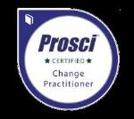

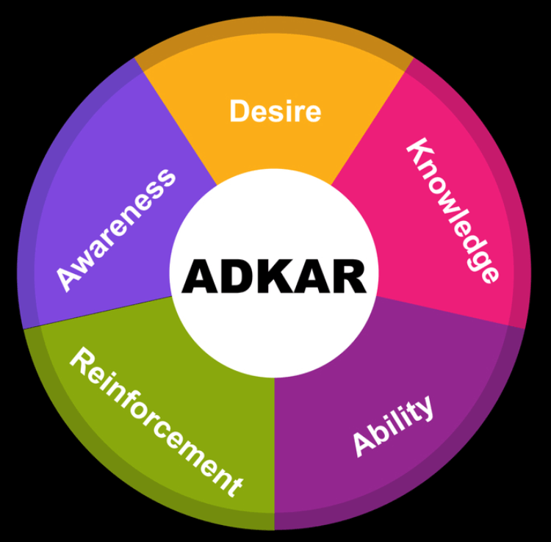
Change Management – Cigna
Certified in
the use of:
Prosci Change Management
Agile methodology
ADKAR model
Working with internal teams, I created and implemented plans to help employees understand the reasons for transition or transformation within the organization and adopt these changes into their daily work. This includes resistance to new technologies, role/process changes and organizational restructuring.*
Prepare for Change
Manage Change
Sustain Change
Complete readiness assessments
Perform risk analysis
Anticipate resistance area(s)
Identify stakeholders
Create/execute plans for:
  Communications
  Sponsorship
  Coaching
  Training
  Resistance
Review feedback from employees and managers
Celebrate success
Ensure adoption for post-project continuity
Tactics / Activities
Tactics / Activities
Tactics / Activities
Change & Risk Assessments
Stakeholder Interviews
Audience Impact Assessment
Sponsor Engagement Assessment
Communication Strategy
Stakeholder Analysis
Create individual plans to integrate into project plan
Change Management Network
Collect feedback (ongoing)
Celebrate success (ongoing)
Review to ensure adoption
Change Management Network (ongoing post-project)
*This is a sample project only. Each project was customized, based on customer’s needs and assessments throughout the project’s lifespan.

Slide 16
22 Years’ Experience
Corporate Communications
Partner Communications & Newsletters
Media Relations, Pitching & Placement
Branding / Rebranding
Key Messaging
Partner / Vendor Appreciation
Press Releases
Web Site & Social Media Content & Strategy
Product & Services Highlight Sheets
External
Communications

Slide 17
Media Experience
I have worked as both a member of the media and, later, as a representative to the media. This experience has taught me the best ways to craft a message and deliver it to the right audience for maximum impact.
Journalist
23 years as reporter, writer, managing editor, editor-in-chief and editorial director
10 years of publishing experience
Bylined and ghost-written articles for leadership
Content planning, targeting audiences
Staff management (editors, graphic designers, freelancers, interns)
Industry awards for article writing, magazine design, web site content, newsletters and media exposure
Media Representative
17 years’ experience
Media relations representative for Siemens Healthcare, Executive Health Resources, Optum/United Health Group and ATRIO Health Plans
Earned media, crisis management, media pitching, media events, spokesperson
Experience working with traditional and electronic media (national and trade), television, social media, national and global organizations
To view writing samples, visit https://tomschaffner.com/media-portfolio/

Slide 18
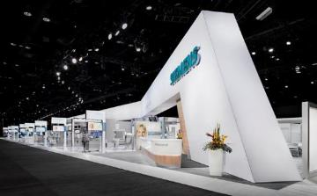
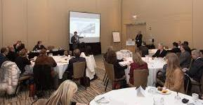
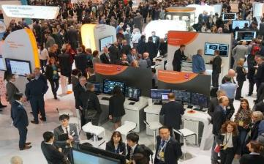
Media Relations Campaign – Siemens (2008-2010)*
I directed this six-month media campaign annually, promoting Siemens Healthcare’s business divisions’ leadership, products and services at the annual Radiological Society of North America (RSNA) conference (>60,000 attendees annually).
Business Units Represented:
Medical Imaging & Oncology division
Healthcare IT division
Laboratory Diagnostics division
Press Releases:
34 press releases distributed nationally and internationally
14 new products launched
70 Siemens leadership and subject matter experts quoted
Media Booth Tours:
162 booth tours for trade and national media reporters, professional association representatives and industry analysts
141% increase in number of booth tours over three-year period
Media Breakfast Briefing Event:
Media from the Americas, Europe and Asia provided exclusive access to leadership in an intimate setting
Exclusive 1-on-1 interviews available to attending press
The Siemens Hall
Media breakfast
Booth traffic
*totals over a three-year period

Slide 19
Media Placement Campaign – Executive Health Resources/Optum (2011-2015)
I led the ongoing program to increase the company brand/promote our leadership and subject matter experts in the industry.
Strategy (Print/Online Media):
Increase company brand and subject matter experts in traditional and online media through proactive pitching.
Tactics:
Identify subject matter experts/topics for media availability.
Expand media outreach on hot topic industry issues.
Articles from speaking engagements for media placement.
Pitch to professional organizations for company-authored articles for inclusion in member newsletters.
Strategy (Social Media):
Establish (Dec. 2011) company’s social media presence through expert content and via discussion forums.
Tactics:
Identify key industry forums for thought leadership content.
Establish a positive experience on social media channels. through engaging contents that link to company content..
Implement a communications strategy of regular tweets (proactive, reactive and evergreen topics) to maintain brand.
611% increase
>40% growth each year
* # of new posts ** proactive and reactive media articles

Slide 20
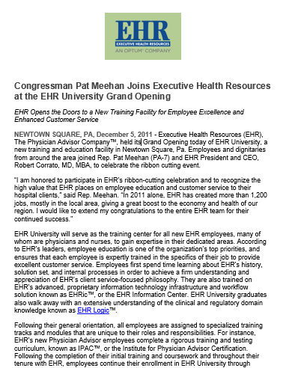
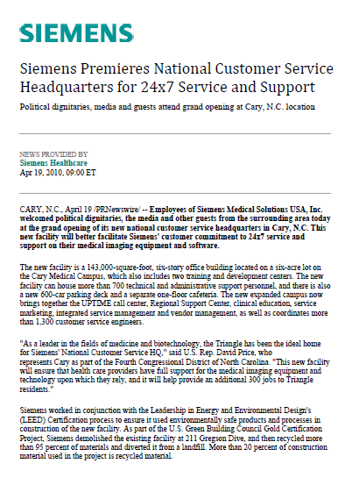
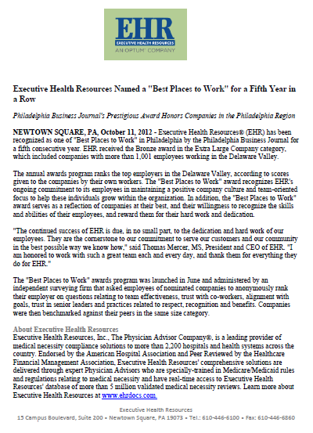
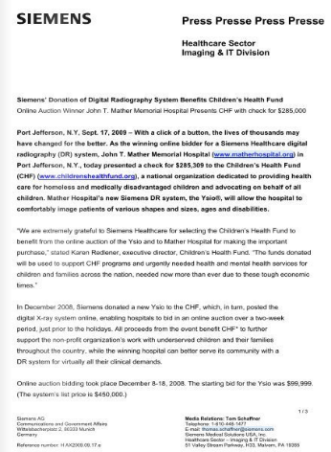
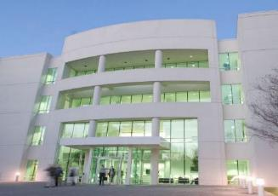

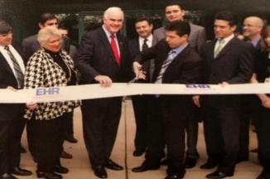
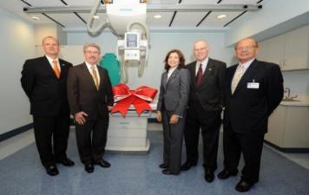
Press Releases
Press release examples I created and coordinated the distribution of for local and national media coverage.

Slide 21
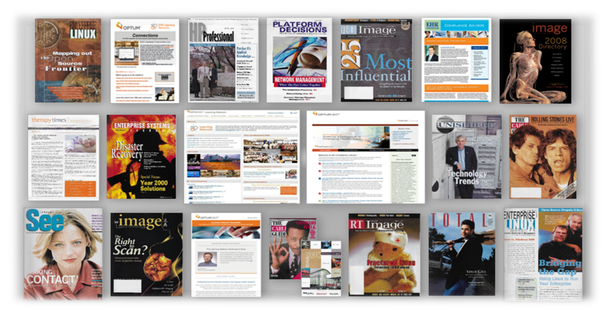
Media Production
In addition to a career as a writer, editor and content strategist, I have experience in all areas of print and digital media production, including magazines, newsletters, Web sites, video, podcasts and social media.

Slide 22
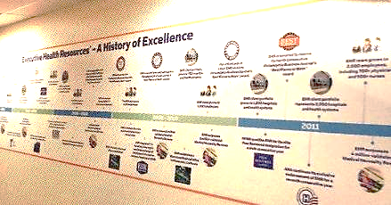
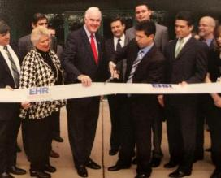
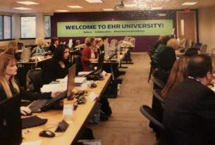
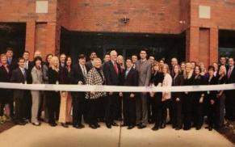
EHR University Grand Opening – Executive Health Resources (2011)
I successfully organized the grand opening event of the company’s new training facility – branded EHR University – inviting company executives, employees, political leadership and local and business media to promote bringing new jobs to the region.
Media/politicians invited, citing the event’s community importance
Media kits produced for press distribution
Ribbon-cutting ceremony agenda planned/implemented
Presentation content created for company leadership
Press release (with leadership/politician quotes) distributed
Media results tracked and presented to leadership

Slide 23



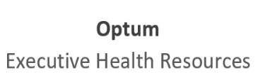

Rebranding Campaign – Optum (2014-2019)
With the challenge of how to build awareness and gain acceptance from our employees, customers and partners, I held leadership roles on every phase of this long-term campaign to promote the gradual transition of the legacy organization and product portfolio to the Optum brand, demonstrating the value of Optum within the organization and throughout the industry.
Soft launch of
Optum rebrand
Legacy name combined with “Optum” in all communications and external materials and now used with Optum logo. (Overall Team Lead)
Supplemental campaign to promote the new internal business unit and its place in the Optum organization and industry. (Team Lead, external content and client messaging)
Optum retains legacy name due to the strength of the brand and recognition with clients and in the industry.
Final transition to
full Optum brand
2010
2016
2019
2014
2017-18
Full launch of Optum brand includes media pitches, direct mailings, industry event promotions, FAQs and internal/external Web site/materials refresh (Team Lead, content employee and client messaging).
“Optum” noted in media references, web sites, internal/external materials and communications to condition clients to rebrand. (Overall Team Lead)
Optum purchases
Executive Health Resource
Next generation
of Optum rebrand
Business unit within
Optum promoted*
*2019 finalist for the Optum Inspire Award for campaign marketing

Slide 24
Branded Items
Examples of a few of the company-branded items I coordinated the production of for promotions and events.
Tote Bag – This bag has been given out at all customer functions for clients to hold their company solutions materials and other items.
Earbuds – Mass produced and affordable, these earbuds were given out as booth draws at conferences, and one of the items placed in client attendee bags.
Tumbler – As part of the launch of a new client engagement group, this item was mailed in appreciation to all newly registered members as a welcome gift.
Water Bottle – Handed out to employees and customers as appreciation items and used as part of the new employee welcome package on their first day.
Journal – The leather-bound journal was mailed to client engagement group members during Customer Appreciation Day the first year of the program.

Slide 25
17 Years’ Experience
Customer Communications
Customer Engagement
Customer Advisory Groups
Customer Appreciation Programs
Web Site Content
Customer Newsletters
Education Courses
Speakers Bureau
Customer Success / Case Studies
Event Management
Marketing Collateral
Customer
Communications

Slide 26
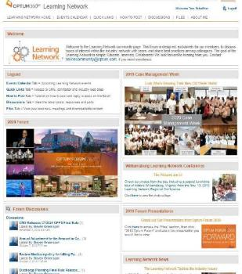

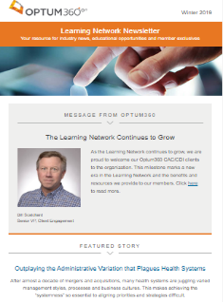
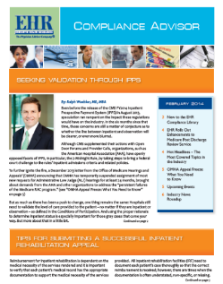
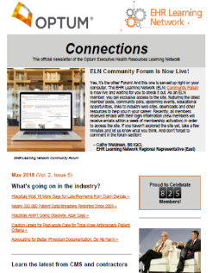
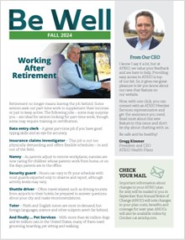


Customer Communication Channels
Examples of media avenues I have created and used to interact with our employees, customers and partners.
Customer-exclusive Web Sites
News, events and educational opportunities
Discussion forums, solutions topics
Exclusive resources, photos and downloads
Site analytics and reporting
Customer Newsletters
Delivered to the client’s inbox
Exclusive information and resources for customers and employees
News, events, tips and downloads
Social Media
LinkedIn, X (Twitter), Meta (Facebook)
Discussion forums, blogs, podcasts, promotions and event information
Site analytics and reporting

Slide 27

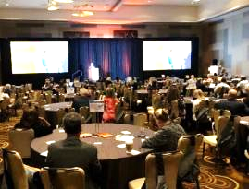
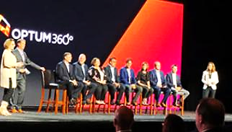
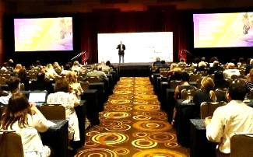
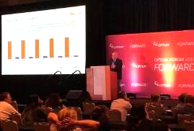
Customer Event Management – Optum Forum (2017-2019)
I led the content creation, promotion and logistics for the business’ premier industry conference. This three-day annual event gathered Optum customers for educational sessions, user group meetings and evening events.
Results
140% increase in annual customer meeting attendance
24% increase customer registrations
20% increase in continuing education credits offered
10% increase in overall conference rating
Communication
- Promotion through email, Web sites, social media
and in-person events
- Leads to Sales/Account Management teams
- Attendee feedback via post-event surveys
Education
- Presentation content, speaker recruitment and supporting materials
- Continuing education credits provided
- Customer speakers provide best practices
Collaboration
- Peer-to-peer interaction and networking events
- Built stronger customer relationships through face-to-face interaction
- Attendee follow-up on questions and information

Slide 28
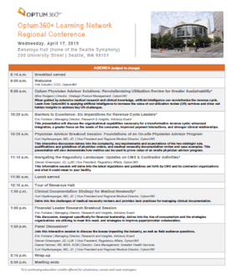
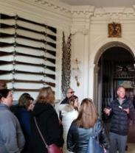
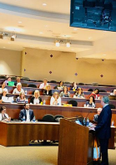
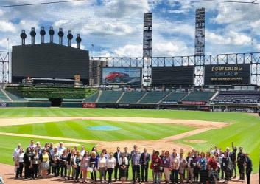
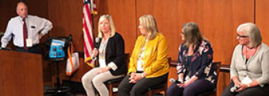
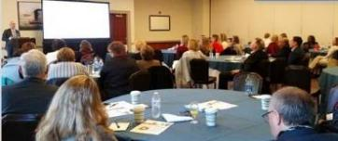
Customer Event Management: Regional Conferences – Optum (2017-2019)
I directed the content, promotion and logistics for these events, offered in targeted cities throughout the country.
  Oversaw all aspects of the event, including:
  Promotion and registration through email, Web sites and social media and in-person events
  Held recruiting team calls; leads to Sales/Account Management
  Recruited and promoted industry, internal and client speakers
  Creation of presentation content and supporting materials
  Vendor, catering and venue and lunchtime tour approval
  Post-event surveys to attendees to gather feedback
  Coordinated continuing education credits for session content

Slide 29

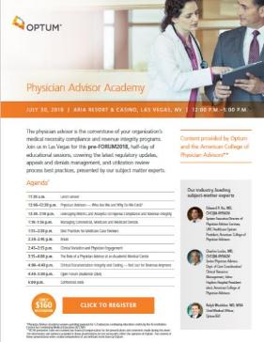
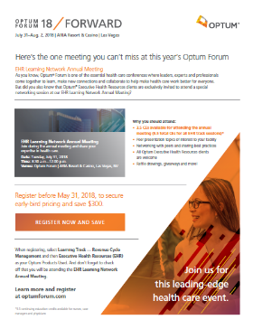
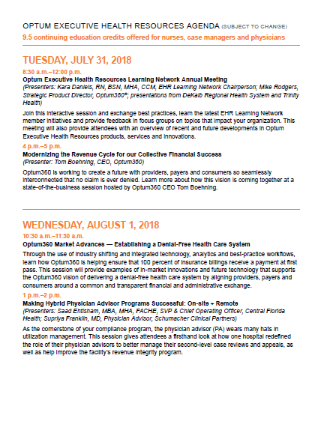
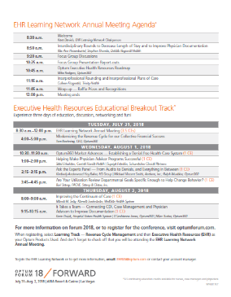
Customer Event Management: Promotion – Optum
Managing numerous customer events throughout the year, I also promoted each to ensure maximum target group registrations.
Pre-Event Communications
Targeted emails with highlights
(e.g., presentation topics, speakers, continuing education credits)
Registration
Registration site creation
Analytics (registrant and attendee information)
Follow-up
Continuing education credits information
Attendee surveys
Event results/feedback for leadership

Slide 30
Customer Engagement Program – Optum (2017-2019)
I was tasked with rebuilding of the existing customer user group in which customers enjoy exclusive benefits with membership. This included educational opportunities, networking with Optum subject matter experts and other customers to promote customer engagement and loyalty, curb client retention and increase Net Promoter Scores (NPS) for customer satisfaction.
Legacy organization
Launching the new customer organization
Building on
the success
Continuing the momentum
Created and implemented initiatives to introduce the new customer program. Challenge: Retain current membership, while increasing total membership.
With the foundation laid, additional programs are rolled out.
Focus on member growth and program participation
Launched in 2014
Membership
257
495
1,038
2,078
2014-16
2017
2018
2019
Quarterly member meetings (3 virtual, 1 at Optum Forum annual conference. This was the only program offered
Customer organization was not actively promoted
Customer organization name and logo announced
Customer webinar series launched
Customer presenter(s) on all webinars to provide peer comments and best practices
Continuing education credits offered for all educational webinars and events
Member Appreciation Day established
Organization promoted in all media
Monthly member newsletter published
Customer board / roles expanded
Enhanced member communications
Member Web site launched
Recognition and awards program announced
Board committees established
Customer and Optum experts’ podcasts launched
Web site enhanced
Net Promoter Score*
37
51
65
67
*Net Promoter Scores based on bi-annual customer satisfaction surveys

Slide 31
Customer Engagement Campaign – Optum (2016-2019)
Customer campaign I created and led to promote Optum as the industry thought leader and provider of healthcare solutions. Mailings sent to the director of case management at each client hospital in celebration of National Case Management Week.
2016
Printed (online version available) career guide for case managers, directors and revenue cycle staff with articles to help ensure compliance, improve processes and return on investment
2017
40-page desktop flip book containing helpful resources for case management teams
Custom-themed t-shirt also delivered to client facility in the mailing
2018
Poster containing best practices, helpful tips and process enhancements for department display
Custom-themed t-shirt also delivered to client facility in the mailing
Link to online resources
Trackable links to online client-exclusive resources
Trackable links to online client-exclusive resources
2016 Net
Promoter Score*: 37
2017 Net
Promoter Score*: 51
2018 Net
Promoter Score*: 65
*Net Promoter Scores based on bi-annual customer satisfaction surveys

Slide 32

Compliance Awareness Campaign – Executive Health Resources/Optum (2016)
As the result of new government regulations on how hospitals determine patient care and status for Medicare reimbursement, I led the content creation and communications strategy on this campaign to create information, provide best practices and guidance to reassure customers of the importance of using the company’s clinical teams for review of their patient records to help ensure compliance and proper reimbursement and prevent claims denials.
Mailing
Dimensional mailer delivered to case management director, CEO and CFO of each client hospital
Account Managers provided collateral for customer follow-up
Media
Corporate Web site promotes e-version and additional thought leadership/best practices content
Communications
Email to all customers with dimensional mailer download link
FAQs to better understand and navigate new regulations
Proactive media push to highlight Optum expertise
Tweets/blog posts to provide analysis of new regulations

Slide 33
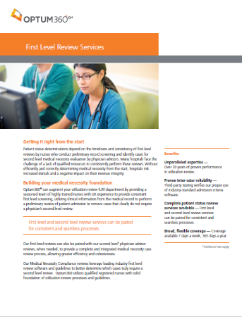
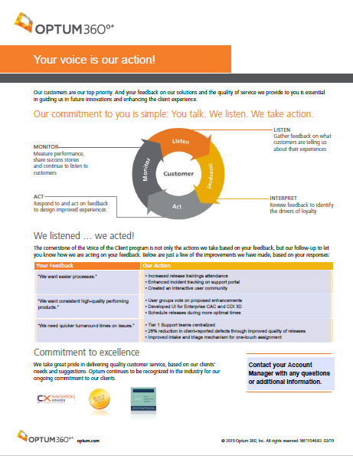

Brochures / Flyers
Examples of marketing support materials I created and worked with the graphic design team to promote the organization, its products and other company services.
Customer Feedback
Provided Account Managers with an avenue to encourage client comments on our products/services and show how their suggestions help us to produce positive results for them.
Supplemental
Services Offered
Educated customers on additional services the company offers that they may not be aware of and the value it can bring to their organizations.

Slide 34
16 Years’ Experience
Employee, Customer, Partner Communications
Strategic and Investor Communications
Organization and Crisis Communications
Management Toolkits
Key Messaging, Talking Points & FAQs
Speechwriting / Speaking Engagements
Presentation Content
Ghost-Written Articles
Social Media and Blog Posts Strategies
Executive
Communications

Slide 35

Employee Engagement
For more than 20 years, I have worked directly with company executives – in organizations of all sizes – to ensure that the lines of communication between leadership and their teams are strong, consistent and transparent.
My top priority is to establish the executive’s voice as a leader who builds trust, increases morale and drives productivity among employees and clearly defines the organization’s vision and goals. I achieve this through the creation and implementation of*:
Internal communications plans
Company events
Town Halls (content, speakers, Q&As)
Culture and engagement programs
Reporting organizational changes, milestones and wins
Employee awards and recognitions
Change management strategies
Executive briefings and analysis of employee surveys
*not a comprehensive list

Slide 36

Industry Awareness
Building and maintaining a positive image of any organization starts with leadership. Our leaders not only become the representatives of the company and promoters of our brand, but our champions throughout the industry. I always strive to ensure they are well prepared with our key messages, talking points and the best way to communicate the company’s vision.
It is critical that leadership stay in touch with the needs of our customers and partners and the challenges in the industry. I achieve this through*:
Branding
Key Messaging
Speaking Engagements
Customer & Partner Communications
Crisis Communications management
Investor Relations interaction
Talking Points and FAQs
*not a comprehensive list

Slide 37

Media Coverage
A strong relationship between an organization and the media is critical to health of the business. As the primary spokespeople for the company, leadership has a responsibility to not only present information in a consumable way, but to relay a sense of expertise and credibility.
As both a former member of the media and a representative to the media, I have a unique perspective on how information is best delivered with optimal results. I achieve these outcomes by*:
Targeting the audience and media channels to use
Bylined/ghost-written articles (e.g., profiles, case studies, white papers) for leadership
Proactive media pitching and earned placement
Media training and interview preparation
Addressing the issues and reiterating key messaging
Strategic social media, blogs, podcasts
Storytelling with broad appeal
*not a comprehensive list

Slide 38

Thomas Schaffner
schaffnertf@gmail.com
267-251-1459
www.linkedin.com/in/tomschaffner
https://tomschaffner.com/ (portfolio)

